Slide 1
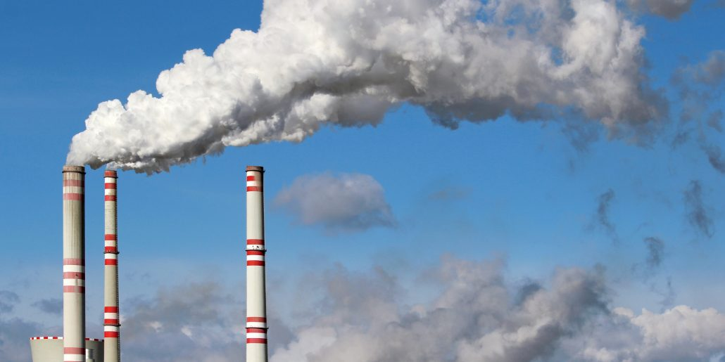
HSPH Capstone Project
Modeling Pollution
Members: Casey, Chris, Justin, and Keyan
TF: David Sondak
Notes:
Hello everyone! As a brief reminder, we are working with the Harvard School of Public Health with help from David Sondak to model PM 2.5

Slide 2
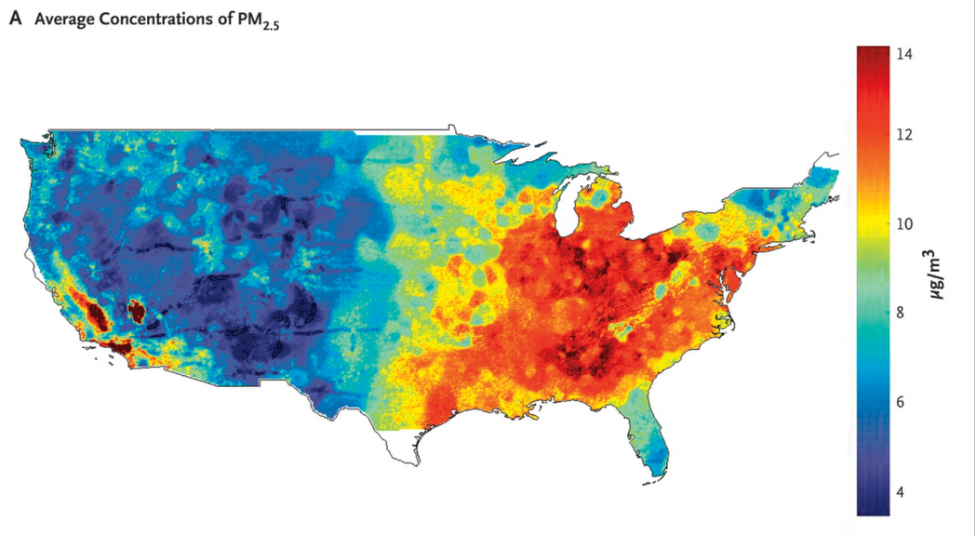
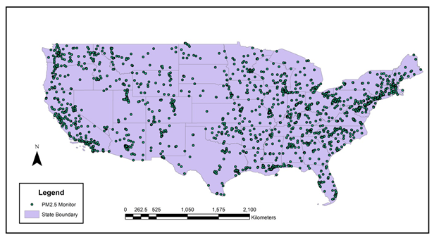
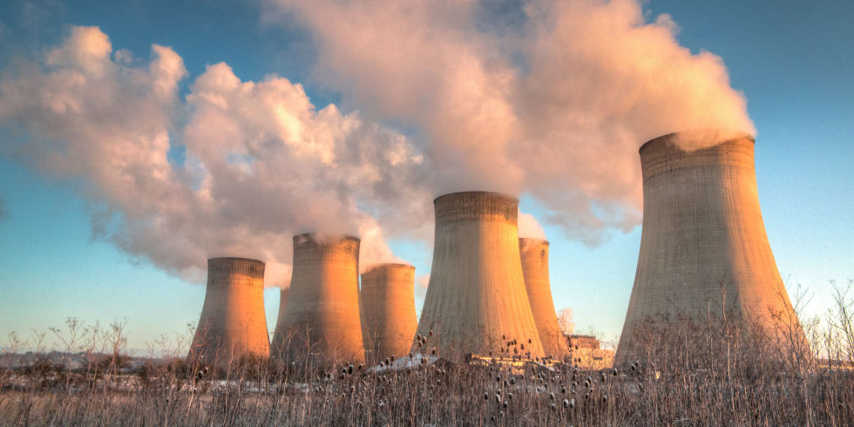
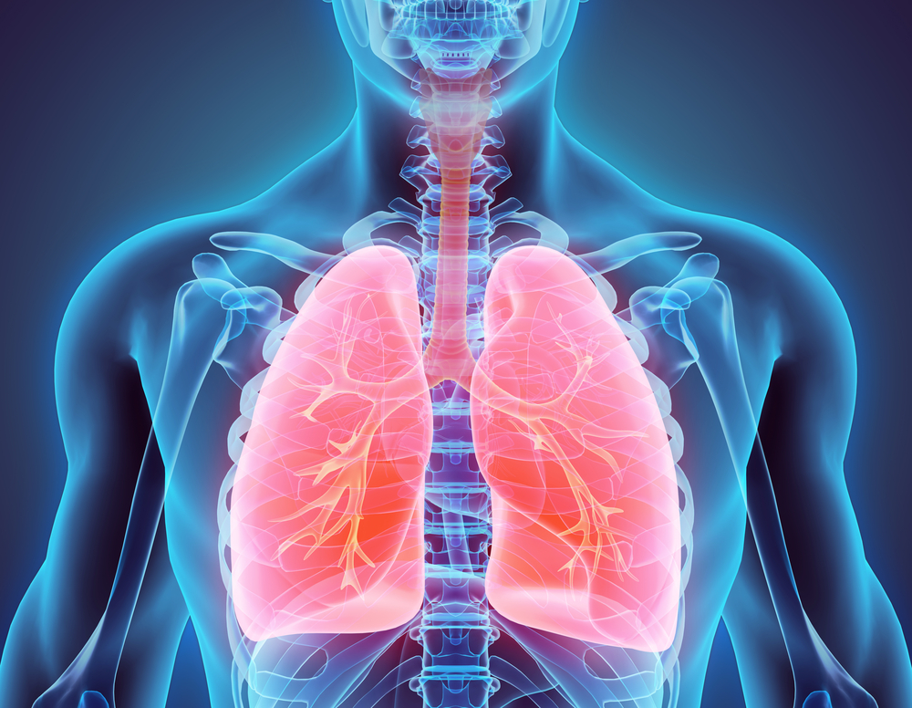


Big Picture - Problem & Motivation
Pollution Map
Pollution Sensor Data
Pollution Map
Causal Relationships
Notes:
Using pollution data from sparsely distributed sensors located throughout the country, our goal is to interpolate pollution on a daily level throughout the entire US, create a continuous map of pollution on a daily level throughout the US, which will ultimately be used to establish causal relationships between pollution and health outcomes.

Slide 3

Big Picture - Missing Data
There is a lot of missing data in both the predictors and the response
We have implemented the iterative “missForest” algorithm to impute missing values
Notes:
In order to do this, a big obstacle that we had to overcome was the amount of missing data. After some research and experimentation, we decided to implement an iterative random forest imputation algorithm, which after some validation, seems to have given us fairly good imputations.

Slide 4
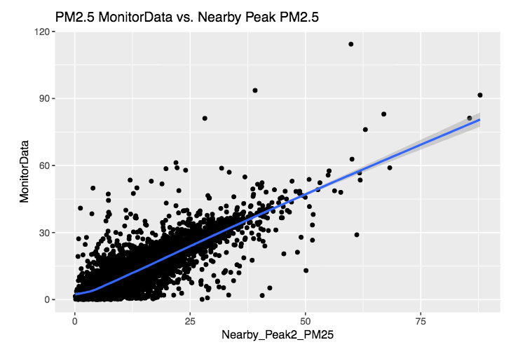
Big Picture - Nearby Pollution
Notes:
However, thus far, the modeling results are not particularly sensitive to the quality of imputations likely because of the disproportionate importance of one variable, nearby PM 2.5. Consequently, we are implementing models that explicitly incorporate nearby terms both spatially and temporally.

Slide 5
Full-Scale Results
Model | Subset (1%) | Full Data
Ridge | 0.76 | 0.75
Random Forest | 0.78 | 0.77

Slide 6

Current Status - Software Package
All HPC currently done on Odyssey
HSPH team works on Harvard/MIT Research Computing Environment (RCE)
Work with HSPH team to determine best options for turnover and continued use as semester ends

Slide 7
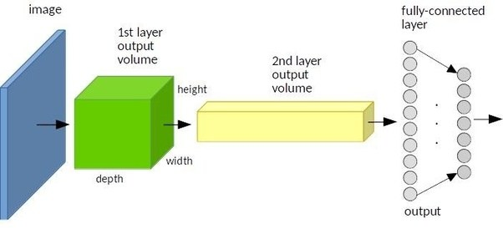
Current Status - Modelling
Run and validate results of CNN on fully imputed dataset
Implement Gaussian processes for interpolation and compare results to CNN and other methods

Slide 8
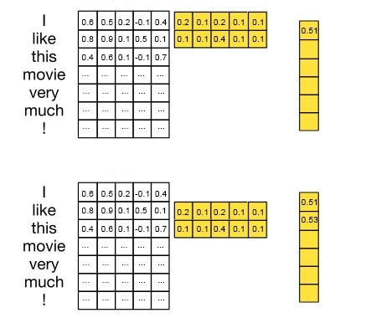
CNN Architecture
Input vectors
Weight matrix
Hidden
CNN makes sense in this context
Days close together are likely to be related in ways that are relevant to pollution
Usage of CNN in this context analogous to how CNNs used for NLP
1D convolutions

Slide 9
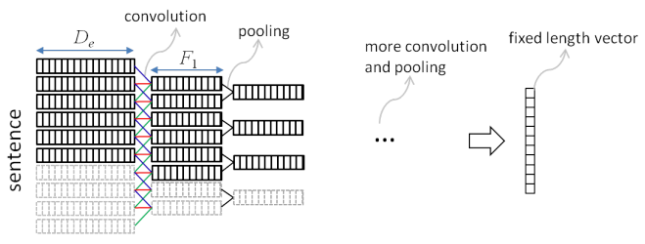
CNN Architecture
Use kernel width of size 3 so that features from previous day, current day, day after are used for predicting pollution for current day
Will tune kernel width
Sensor-day vectors
Hidden outputs

Slide 10
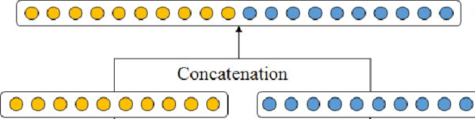
CNN Architecture
Inputs to convolutional layer:
Features that change on a daily basis within a sensor sequence
Features that are constant throughout a sensor sequence:
Concatenated with hidden outputs from convolutions
Hidden output from convolution applied to window of days
Features constant over a sensor sequence

Slide 11
CNN Architecture
Many days with missing pollution response within each sensor sequence
Have to extract hidden outputs for which there exists a pollution response
Pollution outputs
Sensor-day vectors
Some NAs
Hidden outputs

Slide 12
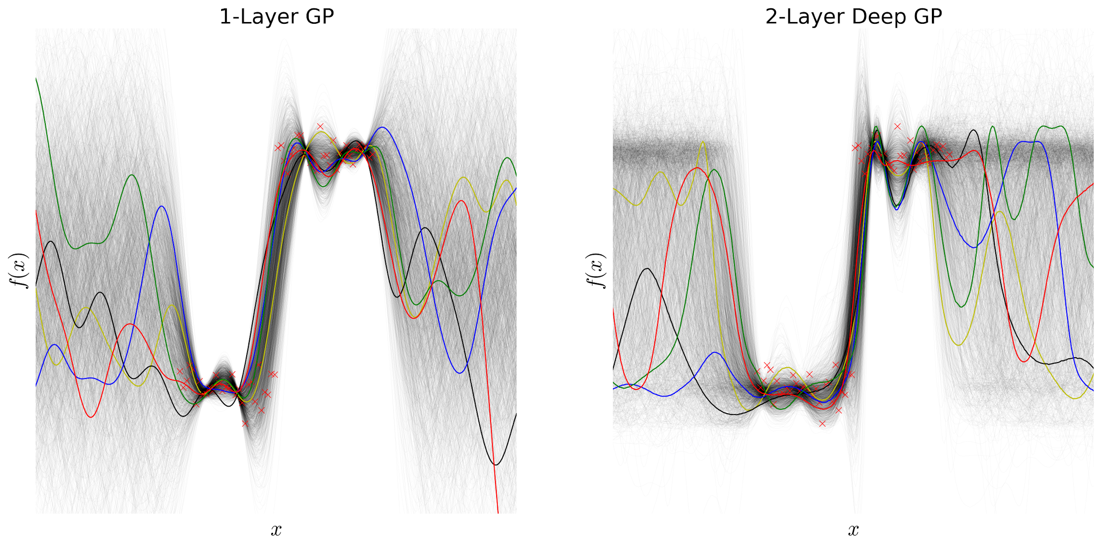
Using Nearby Terms - Gaussian Processes
Use strong spatial & temporal correlations
New strategy for predicting in sensor-less areas
Inherent error estimates

Slide 13
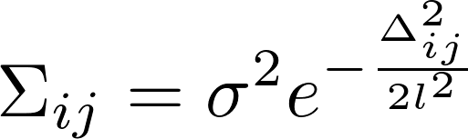
Correlations in Time & Space
t₂
t_{ij}
Δ_{ij}
t₁
d_{ij}
t₀

Slide 14
Sampling Provides Pollution Estimates
Time/Space Samples from MVN
Pollution Estimate
{

Slide 15

Sampling Also Estimates Uncertainty
t₂
t₁
t₀

Slide 16

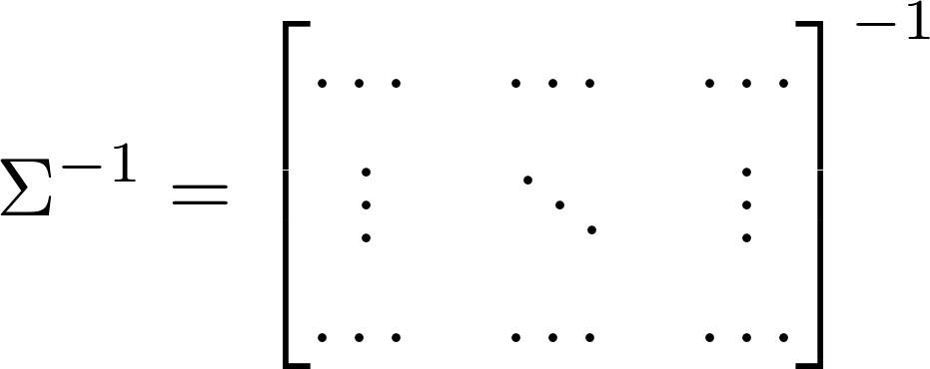
But, Requires Herculean Matrix Inversion

